Slide 1
Evaluation Studies from Controlled to Natural Setting
Samia Arshad
Computer Science Department

Slide 2
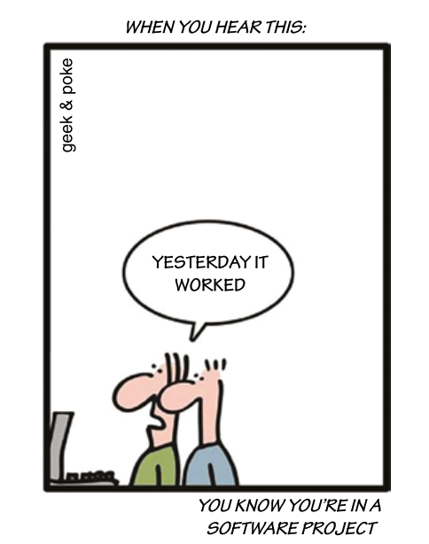
Introduction
Usability testing, which takes place in usability labs and other controlled lab-like settings
Experiments, which take place in research labs
Field studies, which take place in natural settings, such as people’s homes, schools, work, and leisure environments

Slide 3
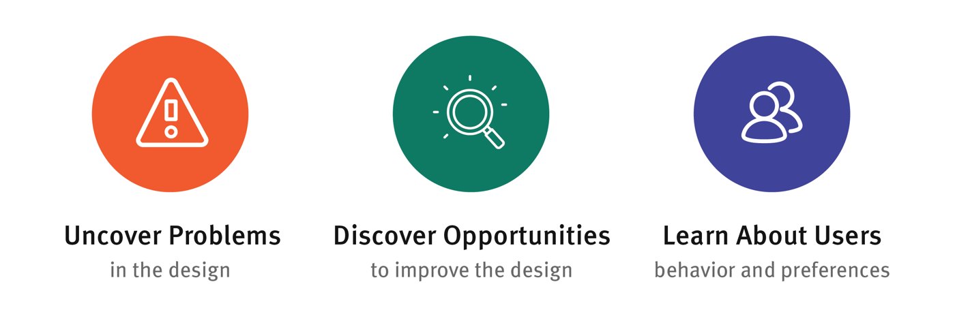
Usability Testing
The usability of products has traditionally been tested in controlled laboratory settings
The goal is to test
whether the product being developed is usable by the intended user in order to achieve the tasks for which it was designed
whether users are satisfied with their experience.

Slide 4
Methods, Tasks and Users
Designers can collect following quantitative performance measures (Wixon and Wilson, 1997)
Number of users completing a task successful
Time to complete a task
Time to complete a task after a specified time away from the product
Number and type of errors per task
Number of errors per unit of time
Number of navigations to online help or manuals
Number of users making a particular error

Slide 5
Lab and Equipment
Digital video camera.
Video tripod.
Good microphone (table, lapel, or headset). A singer’s microphone is no good, because it must be held right next to the mouth.
Headphones (to monitor sound).
Mirror (to capture user’s facial expressions)
Light (desk lamp or video lighting).
Colour video monitor (to view camera image).
DVD recorder.
Video cart.
Powerstrip, extension cables.
“Do not disturb” sign.
Refreshments.
Logging software
Incentives (if required)

Slide 6
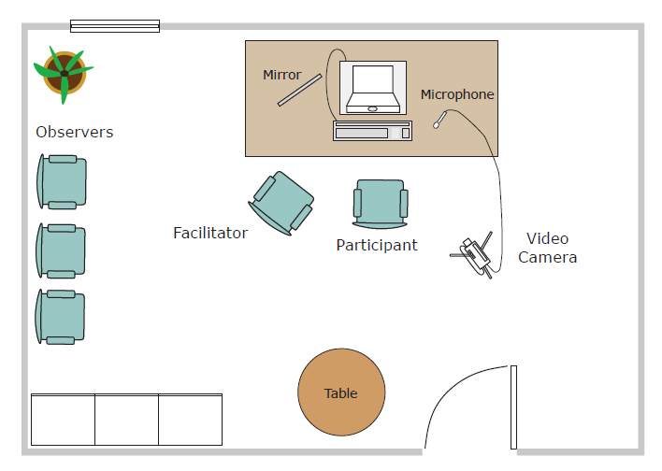
Lab and Equipment - 1

Slide 7
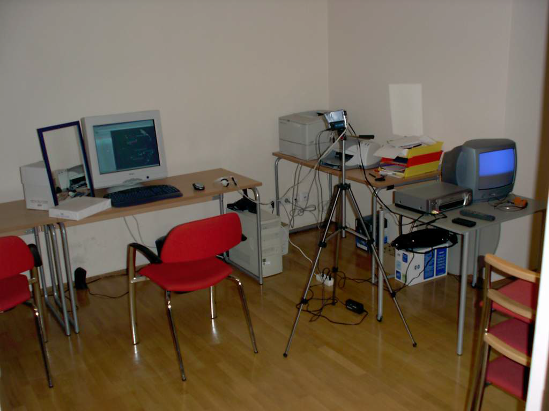
Lab and Equipment - 1 Example

Slide 8
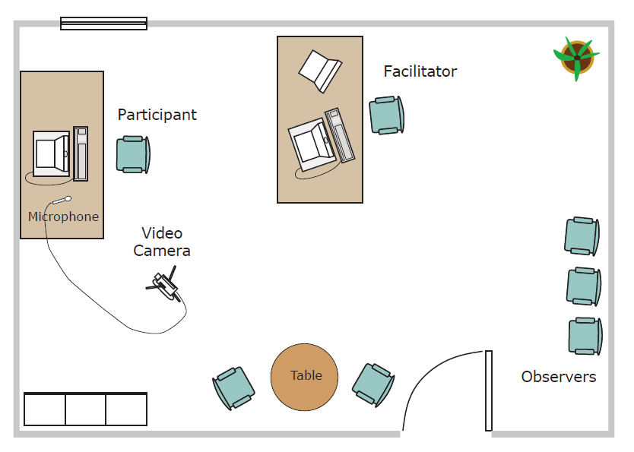
Lab and Equipment - 2

Slide 9
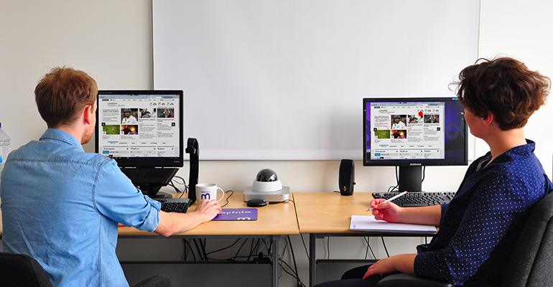
Lab and Equipment - 2

Slide 10
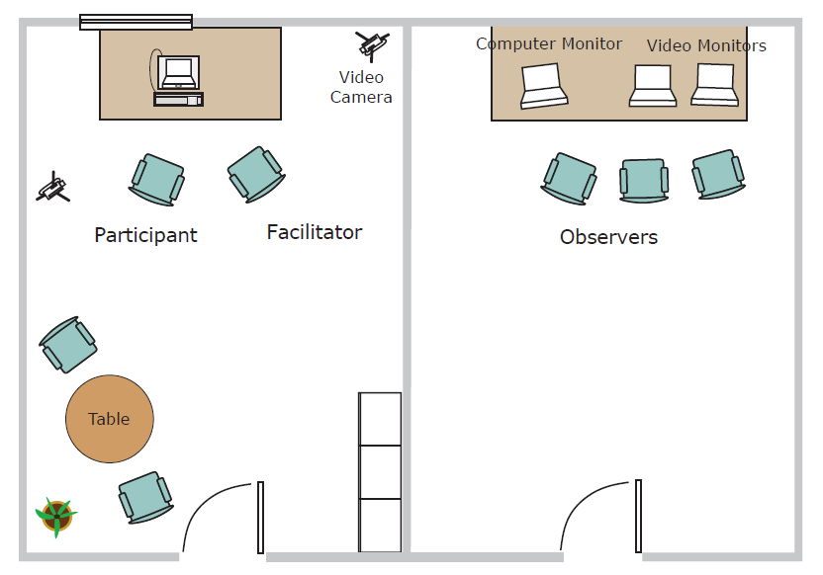
Lab and Equipment - 3

Slide 11
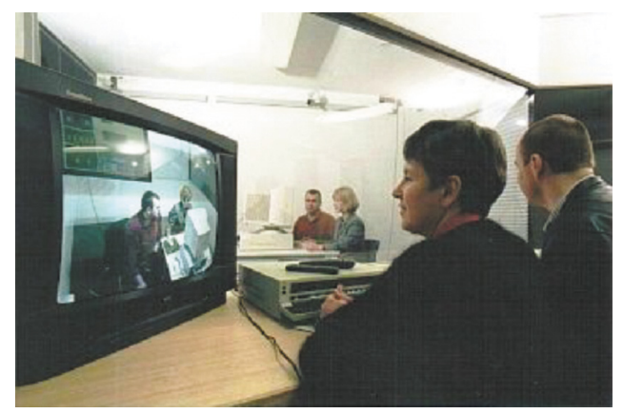
Lab and Equipment – 3 Example

Slide 12
Conducting Experiments
In research contexts, specific hypotheses are tested that make a prediction about the way users will perform with an interface.
The benefits are more rigor and confidence that one interface feature is easier to understand or faster to use than another
Stages
Hypothesis Testing
Experimental Design
Statistics

Slide 13
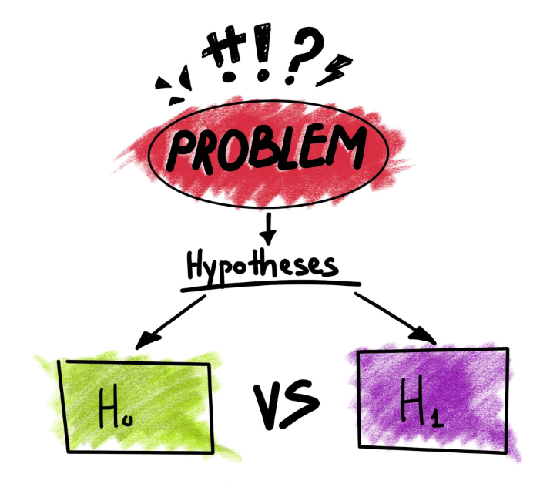
Hypothesis
Hypothesis involves examining a relationship between two things, called variables.
An example of a hypothesis is that context menus (that is, menus that provide options related to the context determined by the users’ previous choices) are easier to select as compared to cascading menus.

Slide 14
Hypothesis Variables
Variables can be independent or dependent.
Independent variable is what the researcher manipulates (that is, selects).
in the previous example, it is the different menu types.
Dependent variable is a measure of user performance
in previous example this is the time taken to select an option and if our hypothesis is correct, will vary depending on the different types of menus

Slide 15
Hypothesis Types
Null
No relationship exists between variables
Alternative
There is a relationship between two variables
One-tailed
the hypothesis can be stated in terms of one effect.
e.g. it is faster to select option from context menu.
Two-tailed
when a difference is specified but not what it will be.
e.g.it is faster to select options from the context menu or the cascading menu.

Slide 16
Hypothesis Testing
To test a hypothesis, the researcher has to
set up the conditions and
find ways to keep other variables constant
to prevent them from influencing the findings. This is called the experimental design.
e.g.screen size etc.
Hypothesis testing can also be extended to include even more variables, but it makes the experimental design more complex.

Slide 17
Experimental Design
A concern in experimental design is to determine which participants to involve for which conditions (also called treatments) in an experiment
Different-participant design
Same-participant design
Matched-pairs design.

Slide 18
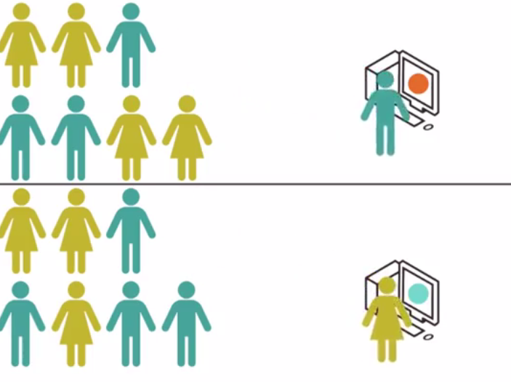
Different-Participant Design
In different-participant design [between-subjects design] a single group of participants is allocated randomly to each of the experimental conditions so that different participants perform in different conditions.

Slide 19
Different-Participant Design
Pro
There are no ordering or training effects caused by the influence of participants’ experience
Con
Large numbers of participants are needed so that the effect of any individual differences among participants, such as differences in experience and expertise, is minimized.

Slide 20
Same-Participant Design
In same-participant design [also called within-subjects design] all participants perform in all conditions, main reason for this design is to lessen the impact of individual differences.
only half the number of participants is needed
see how performance varies across conditions for each participant.

Slide 21
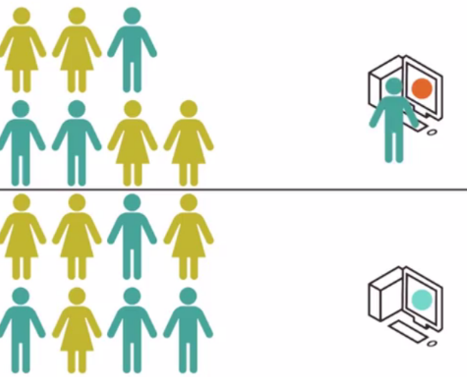
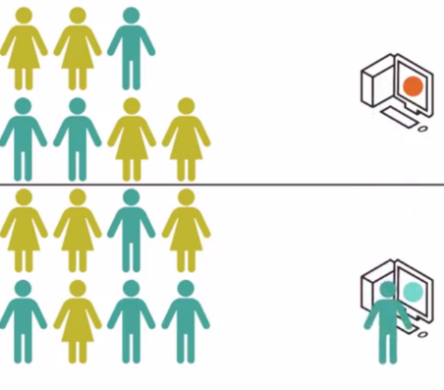
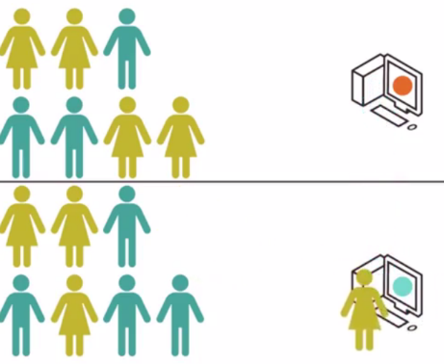
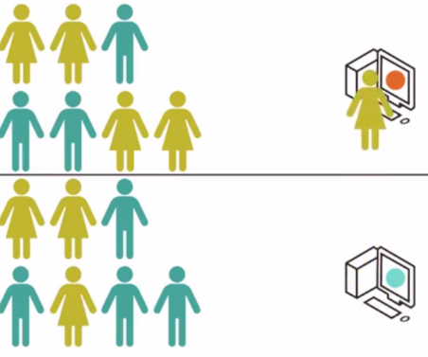
Counterbalancing
Counterbalancing neutralizes possible unfair effects of learning from the first task, known as the order effect.

Slide 22
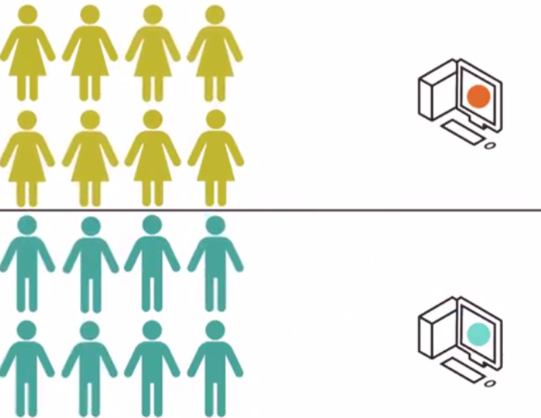
Matched-Participant Design
In matched-participant design [pair-wise design] participants are matched in pairs based on certain user characteristics such as expertise and gender.

Slide 23
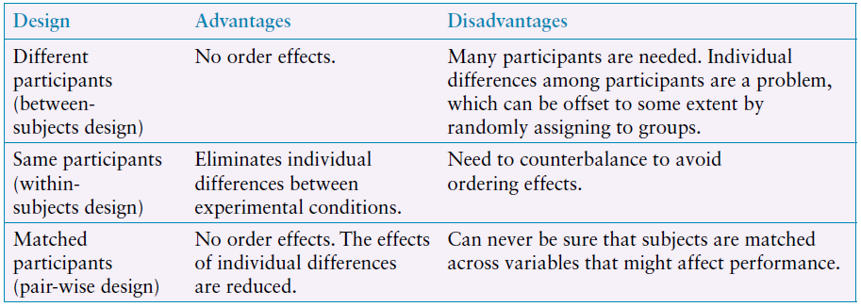
Comparison

Slide 24
Statistics: t-test
A typical t-test result that compared two conditions with 9 and 12 participants each might be as follows:
t 4.53, p 0.05, df 19
The t-value of 4.53 is the score derived from applying the t-test
df stands for degrees of freedom
which represents the number of values in the conditions that are free to vary.
df= (Na-1)+(Nb-1)
p is the probability that the effect found did not occur by chance.
So, when p 0.05, it means that the effect found is probably not due to chance and that there is only a 5 percent possibility that it could be by chance

Slide 25
Field Studies
Studies in natural settings tend to be messy in the sense that activities often overlap and are constantly interrupted by events that are not predicted or controlled.
The trade-off is that it is harder to test specific hypotheses about an interface.
Field studies can range in time from just a few minutes to a period of several months or even years.

Slide 26
Field Studies
Data is collected primarily by observing and interviewing people or paper based or electronic diaries.
Telling them that they are part of a study will likely change the way they behave.
It is also important to ensure the privacy of participants in field studies.
Natural settings are typically reported in the form of vignettes, excerpts, critical incidents, patterns of behavior, and narratives to show how the products are being used, adopted, and integrated into their surroundings.

Slide 27
In the Wild Studies
The term in-the-wild reflects the context of the study, in which new technologies are deployed and evaluated in natural settings
A key concern is how people react, change, and integrate the technology into their everyday lives.
It can demonstrate quite different results from those arising out of lab studies

Slide 28
Other Perspective
To evaluate the efficacy of tools, users are best studied in realistic settings in their own workplaces.
For this the participant will get an introductory training session with the tool, novice usage, mature usage, leading to a semistructured exit interview
Sometimes, a particular conceptual or theoretical framework is adopted to guide how an evaluation is performed or how the data collected is analyzed
Data to be explained in terms of specific cognitive processes, social practices such as learning, or conversational or linguistic interactions.

Slide 29
How Many Participants Are Needed When Carrying Out An Evaluation Study?
User Studies
Professionals recommend 5–12 participants for studies
conducted in controlled or partially controlled settings.
Experiments
Fifteen participants is suggested as the minimum for many experiments (Cairns, 2019).
Field Studies
The number of participants in a field study will vary, depending on what is of interest.

Slide 30
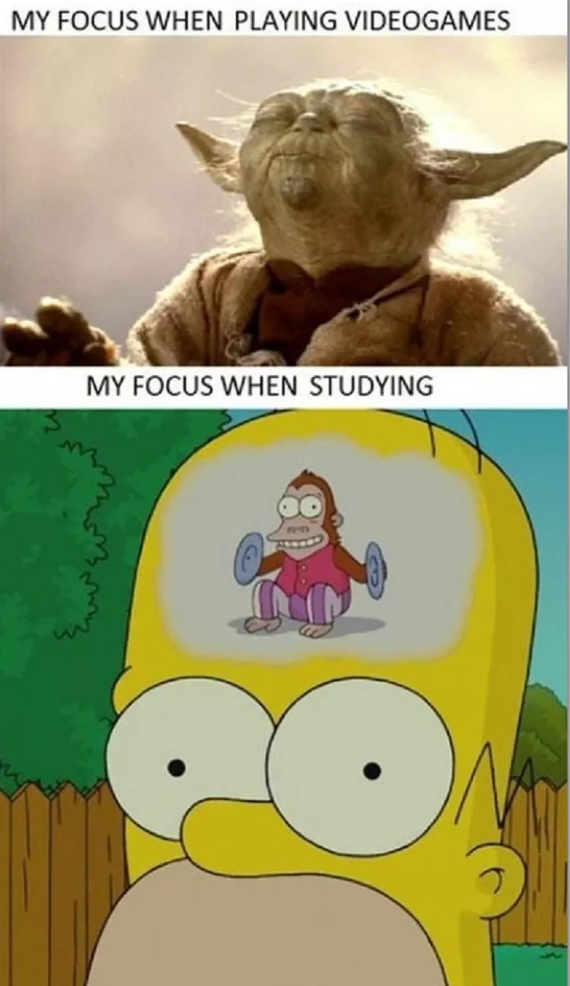
Class Activity
Go to case study of iPad App and Website Usability and gather information about
How user research was conducted?
How field studies were done?
What were the findings?
What were recommendations?

Slide 31
Conclusion
Usability testing
Conducting Experiments
Field Studies

